Slide 1
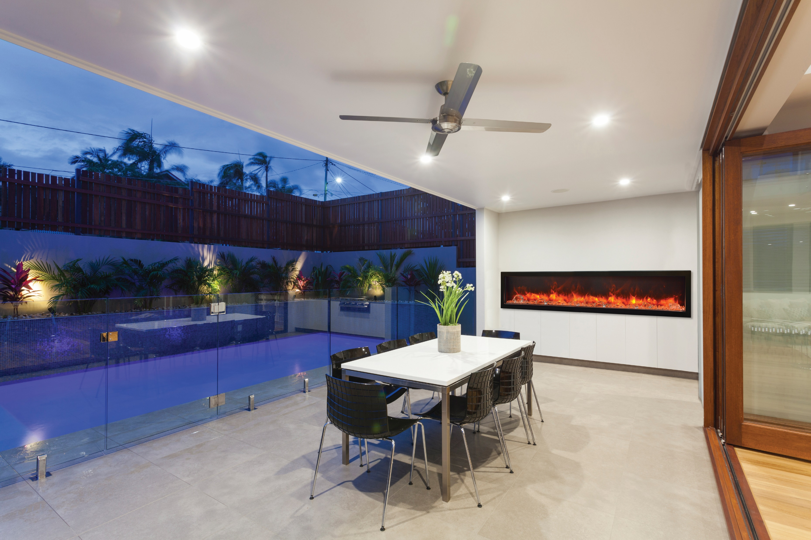

Slide 2
Wall Mount Series
WM-FM GLASS
WM-FML STEEL
WM-BI-2428-VLR BG

Slide 3
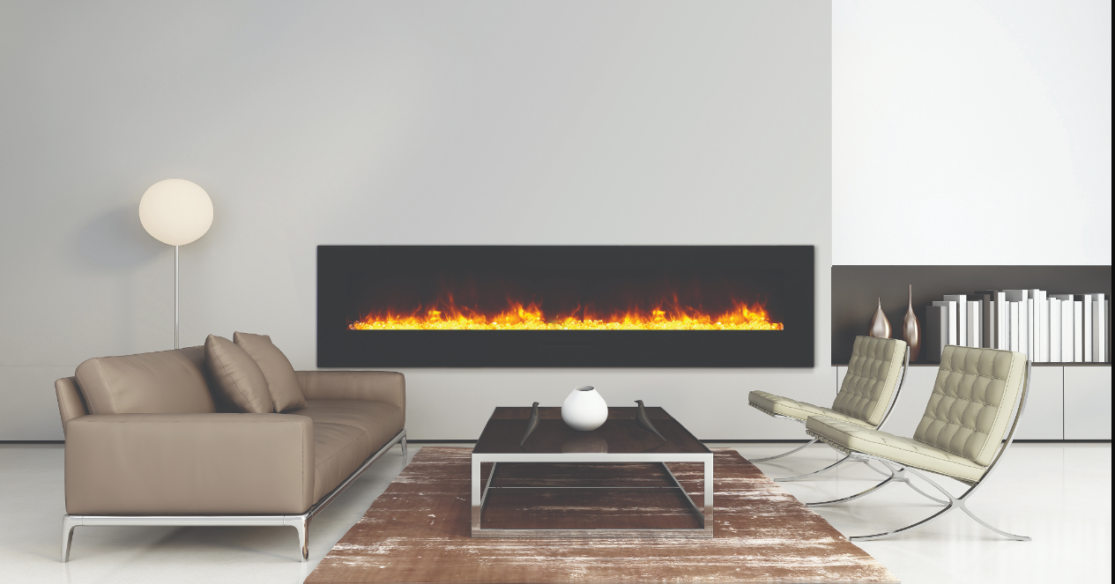
Wall Mount WM-FM Series (GLASS)
7 Sizes to choose from. Select white glass surrounds available for purchase.
Available in sizes – 26”, 34”, 48”, 60”, 72”, 88” and 50” (no back light feature)
Heater & Fan, Flame operates with or without heat
Ideal Applications – Commercial and Residential spaces, New Construction and renovations. Places where construction is not an option (wall mount)
Illuminate decorative media like never before with 13 colours of surround back lit moodlighting
Comes with an installed log set and a remote

Slide 4
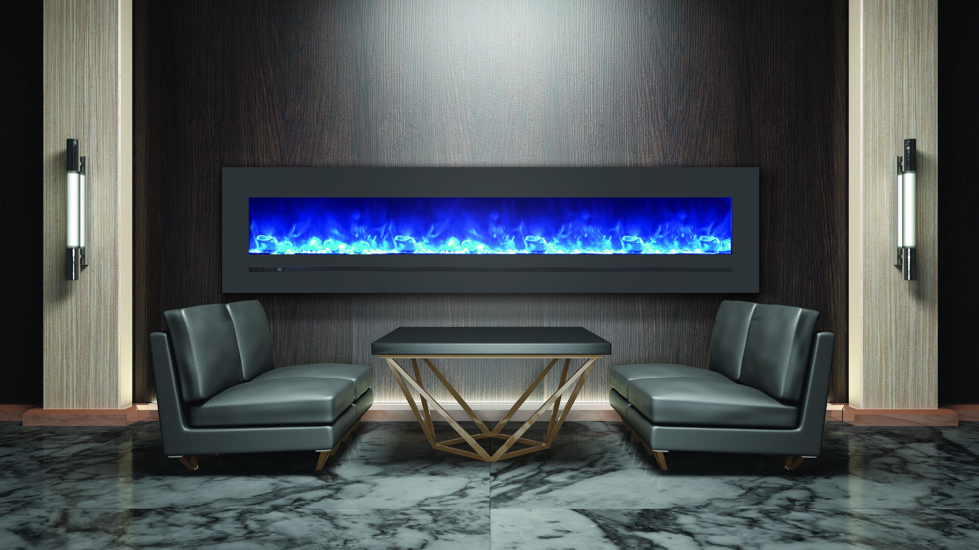
Wall Mount WM-FML Series (Steel)
Sierra Flame by Amantii – Steel Linear Series features a deep charcoal colour steel surround
Available in six sizes – 26”, 34”, 48”, 60”, 72” and 88”
Fire and Ice Flame Presentation – Three light strips allow for yellow, orange, blue, violet and rose colour flames
The steel surround has aesthetic proportions and features a touch pad with numerical temperature display
Heat is emitted through the face below the glass viewing area allowing for a flush mount installation.
Comes with clear decorative media and a remote.
Ideal Applications – Commercial and Residential spaces, New Construction and renovations. Places where construction is not an option (wall mount

Slide 5
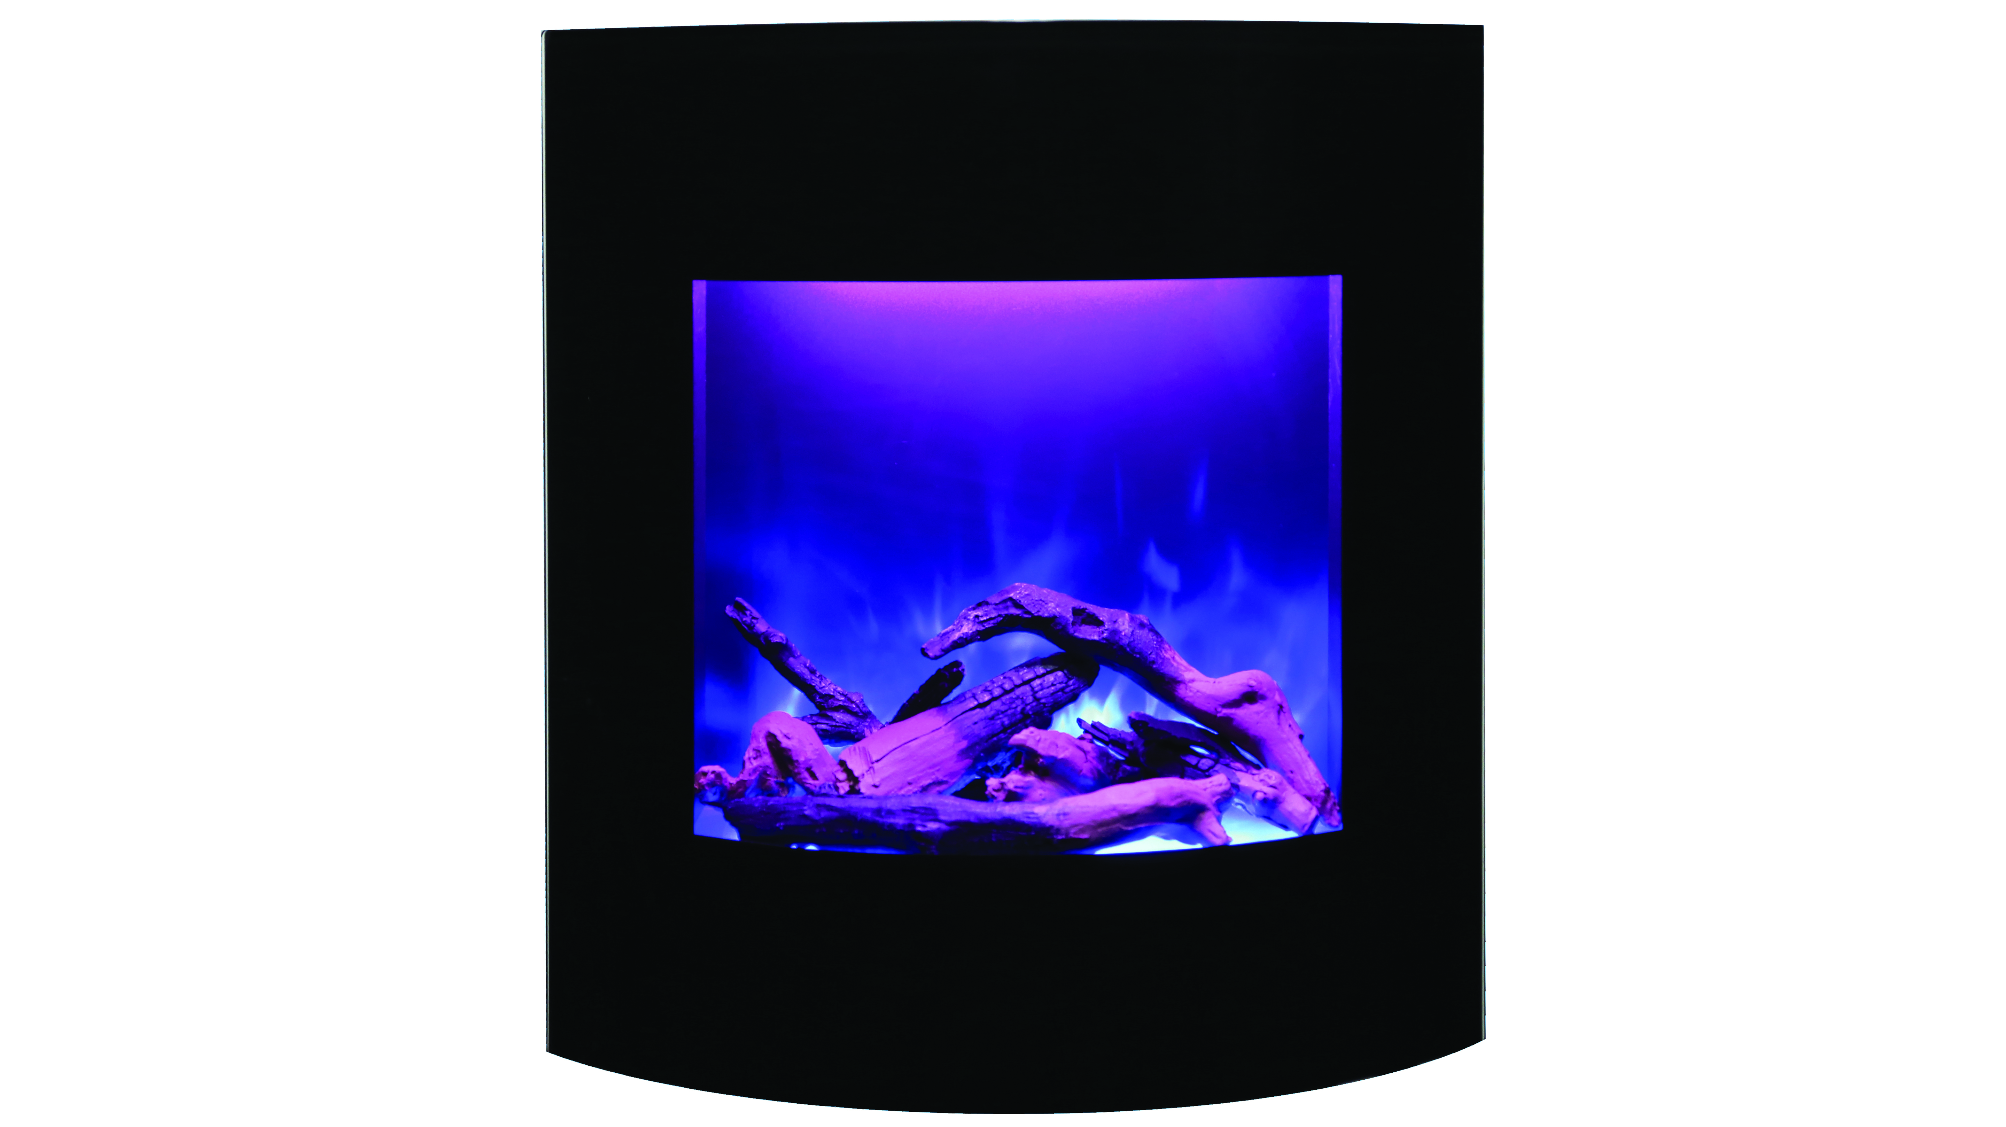
Wall Mount Wm-bi-2428 Vlr-BG
Smart Looking corner electric fireplace is the most versatile unit. Fits beautifully as a corner electric unit.
2 Installation options – Built in or Mounted across a corner
Heat is vented out the top
New Style log is included and is unique to this model and a remote for heat and flames
Curved Surround comes included
Ideal Applications – Commercial and Residential spaces, New Construction and renovations. Places where construction is not an option (wall mount

